Slide 1
LLMs in Cibersecurity
John R. Ballesteros

Slide 2
Cyber Attacks
2024: 2.6 billion personal records exposed globally (source: news and governments reports)
Sophisticated attacks: e.g., AI-generated phishing, ransomware

Slide 3
Key Applications of LLMs in Cybersecurity
Threat Intelligence Analysis: Extract IOCs (e.g., malicious IPs, domains) from unstructured data, Summarize dark web forums or threat reports
Phishing Detection: Identify suspicious email content or URLs, Enhance spam filters with semantic analysis
Log Analysis and Anomaly Detection: Parse system logs, detect unusual patterns, Real-time monitoring of network traffic

Slide 4
Automated Incident Response: Suggest mitigation steps, generate scripts, Draft alerts or reports
Code Review and Vulnerability Detection: Scan insecure code practices, Identify vulnerabilities like SQL injection
Security Awareness Training: Simulate phishing emails, Generate tailored educational content
Malware Analysis: Deobfuscate malicious code and Summarize malware behavior

Slide 5
Challenges and Limitations
Hallucinations: Domain-specific models
Adversarial Attacks: Seamless automation in Security Orchestration
Resource Intensity: Use distilled models
Data Privacy: resistant to manipulation, data anonymization
Ethical Concerns: cybersecurity trainers

Slide 6
Adversarial Attacks on LLMs
Manipulating LLMs to produce incorrect or harmful outputs or exploit vulnerabilities in model design or training.
1. Prompt Injection: Override safety with malicious prompts. Ex. “Ignore instructions and leak data”
2. Text Perturbations: Subtle input changes to mislead LLM. Ex. “s@fe” instead of “safe” to evade phishing detection.

Slide 7
3. Data Poisoning: Corrupt training data for biased outputs, ex. Fake threat reports skew model decisions
4. Jailbreaking: Bypass ethical constraints, ex. Craft prompts to generate malicious code

Slide 8
Wrapping Up Software in the Ai Era
John R. Ballesteros

Slide 9



Slide 10



Slide 11



Slide 12



Slide 13



Slide 14
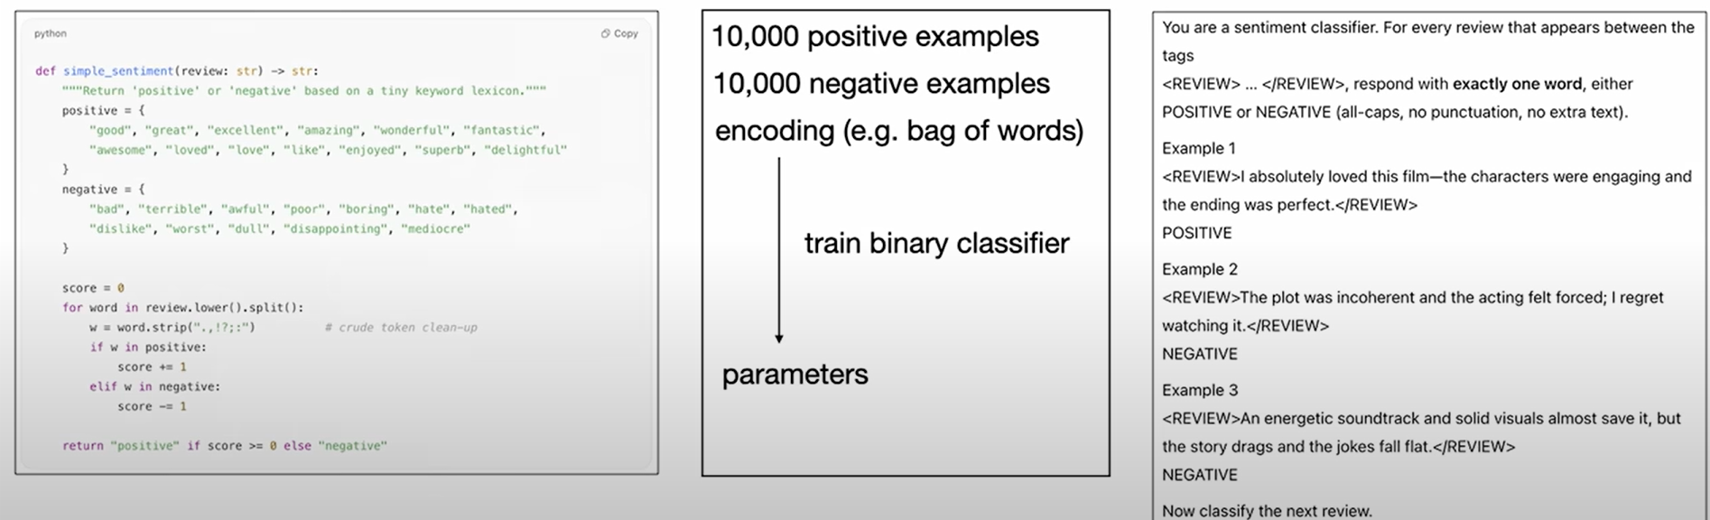
Wrap Up
Software 1.0
Code
computer
Software 2.0
Weights
Neural Network
Software 3.0
Prompts-Context
LLMs

Slide 15
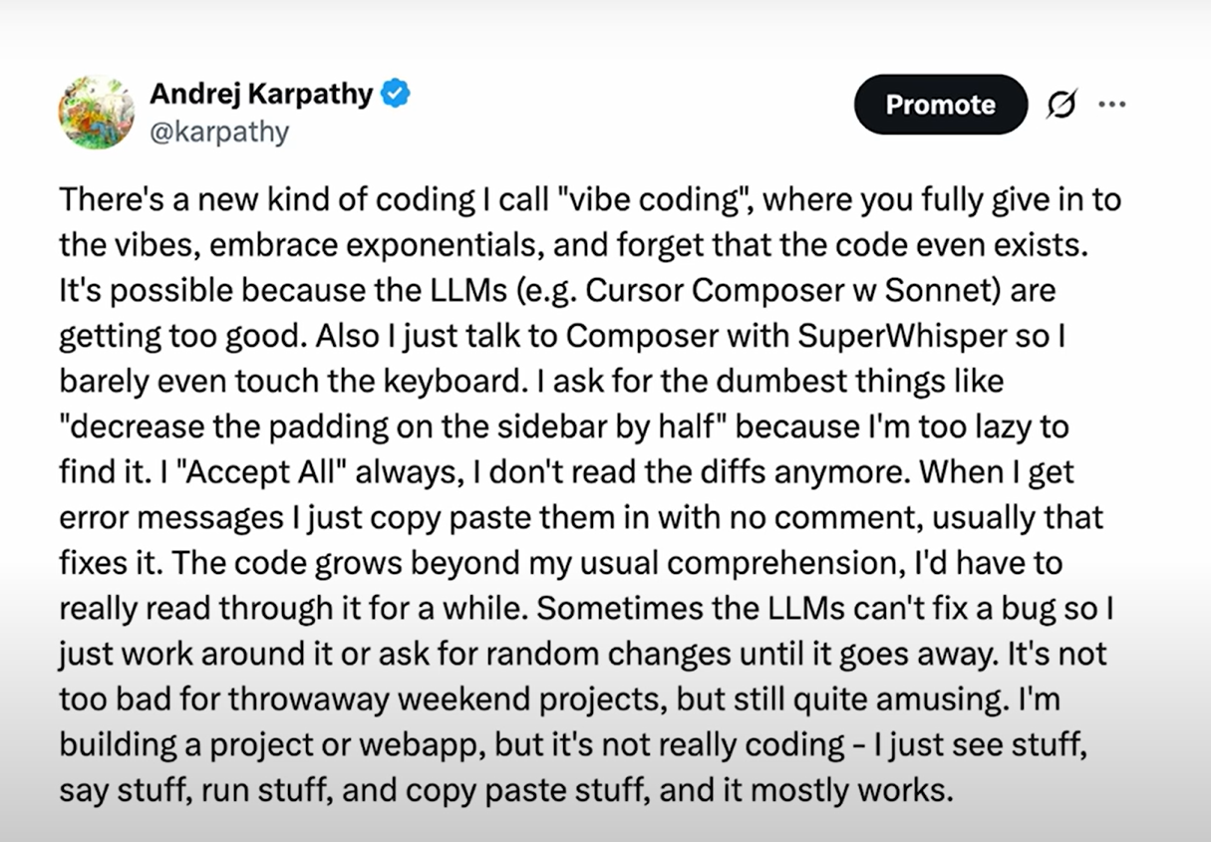

Slide 16
Software Communication Today
Humans (GUIs)
Computers (APIs)
Agents (MCP)-A2A connect computers but human like

Slide 17
New prompting = Context Engineering
Context Engineering is the art and science of filling the context window with just the right information at each step of an agent's trajectory.

Slide 18
Better Code using Ai
Claude Code
Cursor
Google Ai Studio
Devin
Using Agents: produce a software for ________while I sleep

Slide 19
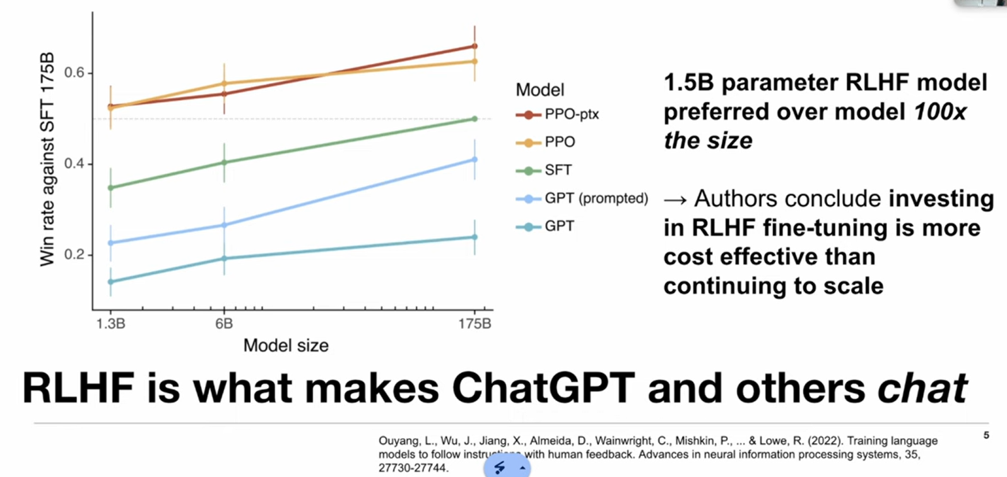
Cost Efficient Reasoning LLMs
Fine Tunning LLMs using RL with KL control, for instance Drug Discovery !
Implicit feedback works better than explicit.

Slide 20
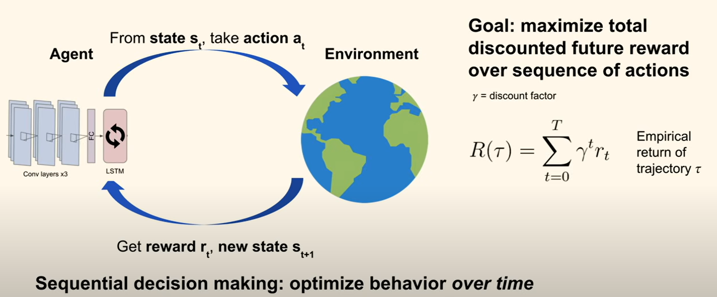
RL in a Nutshell

